Slide 1
ORL 5524-Session 3.0-4.0
Instrument Design and Validation
Madhabi Chatterji, Ph.D.
Professor of Measurement, Evaluation and Education
Director, Assessment and Evaluation Research Initiative (AERI)
Teachers College, Columbia University

Slide 2
AGENDA
1. Review of Homework Assignment Specification of your Assessment Context
2. Types of Validity Evidence (start today and to be continued next week)
Readings: Chatterji (2003) Chapters 3, 13, 5- EA; Validation in EM by Kane (2006)-for enrichment
3. Illustrative case: Instrument design and validation study
(Chatterji & Lin, 2018) Measuring Math Self-efficacy, Math Self Concept and Math Anxiety in Grade 5-6 students
What was the assessment context? How did they implement the Process Model? What was the Validation Plan?
2. Logic of Validation and Validation Plan:
What types of evidence were collected by authors? Did that yield a sufficient body of evidence base defend use and interpretation of measures/“scores”

Slide 3
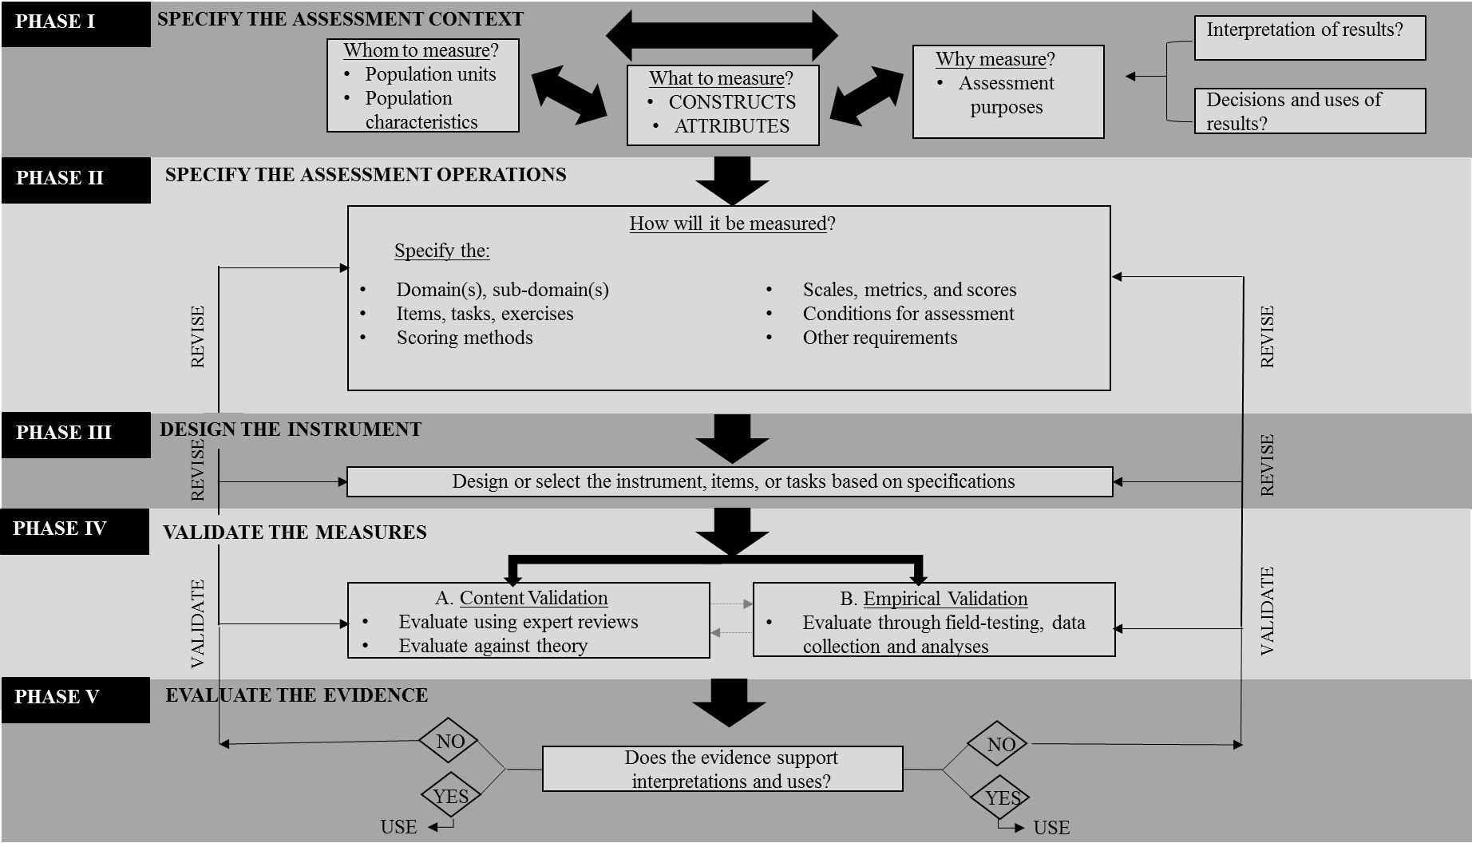
Process Model Version 2.0

Slide 4
RECAP-Steps in Assessment Design Process
Clarify and specify assessment context:
  Identify “whom” to assess (the student group),
  Identify “what” to assess (the constructs/competency domains),
  Identify “why” you are assessing (Is it for research, clinical decisions, classroom assessment or end-of program certification? Is a high stakes/low stakes? Which scores will be used and what inferences will be made from the scores?)
  Identify “how” best to tap into the underlying construct(s).
Specify the “Domains” for targeted constructs with observable indicators.
Develop detailed design specifications (a blueprint) for selecting/writing items, tasks, appropriate exercises, and assembling assessment tools (instrument).
Check for “content validity” using feedback from content experts/assessment specialists or other methods.
  Revise and refine assessment tools, as needed.*
Field-test assessments with appropriate samples from target populations.
Check for validity, reliability and psychometric quality of items/tools using empirical methods.
  Iterate!**
Establish procedures for use and/or dissemination of assessments to maximize validity, reliability and utility.
* OK for classroom or low stakes uses and interpretations
**Needed for uses in higher stakes contexts and complex score interpretations

Slide 5
Quality of Construct Measures
Validity- meaningfulness…
Reliability- consistency and precision…
Utility- practicality…
…of raw scores and any derived score metrics in the specified assessment context ( WHAT, HOW, FOR WHOM, and HOW)

Slide 6
Theoretical debates on validity and validation
Trinitarian view vs. Unitarian (or unified) views
Trinitarian view: Traditional view--began with psychological and educational test design/selection
  Three types of validity (1) content validity (applies to achievement test design); (2) predictive validity evidence (applies to assessments that purport to predict behaviors); and (3) construct validity (applies to validating psychological construct measures with respect to internatl factor structure.
Unitarian view: Modern and dominant view—applies to all types of construct domains and instrument design/selection scenarios (AERA, APA & NCME, 2014). BUT: Not accepted universally (Borsboom & Mellenberg, 2004)
  “All validity is Construct Validity” Lee Cronbach (1971)
  Multiple and suitable types of validity evidence must be gathered and evaluated tied to projected score-based inferential needs, and purposes/uses specified by assessment users ( Messick, 1989; Kane, 2006; Ebel, 1961)
  Reliability, item properties, scaling, norms, standards—all kinds of evidence speaking to the quality of construct measures for the purposes at hand is “Construct validity” evidence

Slide 7
Some Major Types of Validity Evidence
  Content-based Validity
  Evidence of Internal Structure and Dimensionality of Scales (Score Scales from Sub-domains/Domains)
  Convergent and Discriminant Validity
  Criterion-related Validity/Predictive Validity
  Validity based on Group Differences
  Validity based on Item Quality, etc. etc.

Slide 8
Session 3-4
I. Types of Validity Evidence
(1) Content-Based Validity Evidence
Question:
Are the observable indicators of the construct (domains/sub-domains, items, tasks) defensible and consistent with what is known about the construct based on existing knowledge, theory or expert judgment about the construct?
Content-relevance
Content-representativeness
Types of Data Collected: Qualitative or quantitative
Comments of expert judges using structured reviews.
Surveys.
Checklists.
When Collected: Soon after design/selection of instruments, items or tasks
Types of Analyses (examples):
Descriptive Statistics
Qualitative Summaries
(content validity index, kappa coefficients, coded themes).
When is it advisable to collect this type of evidence? [Discuss]

Slide 9
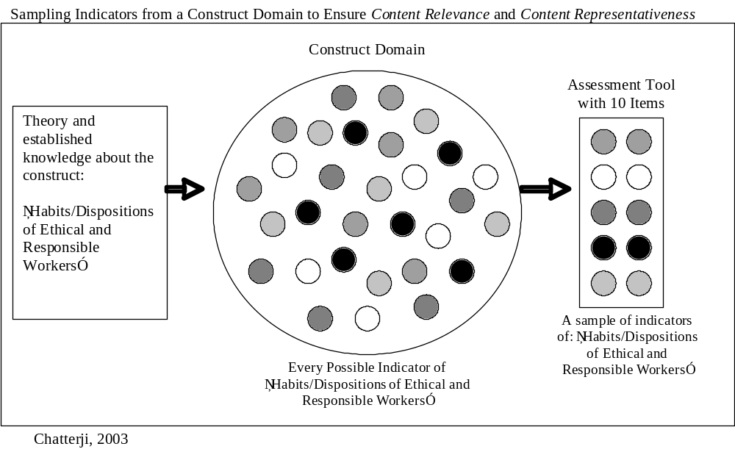

Slide 10
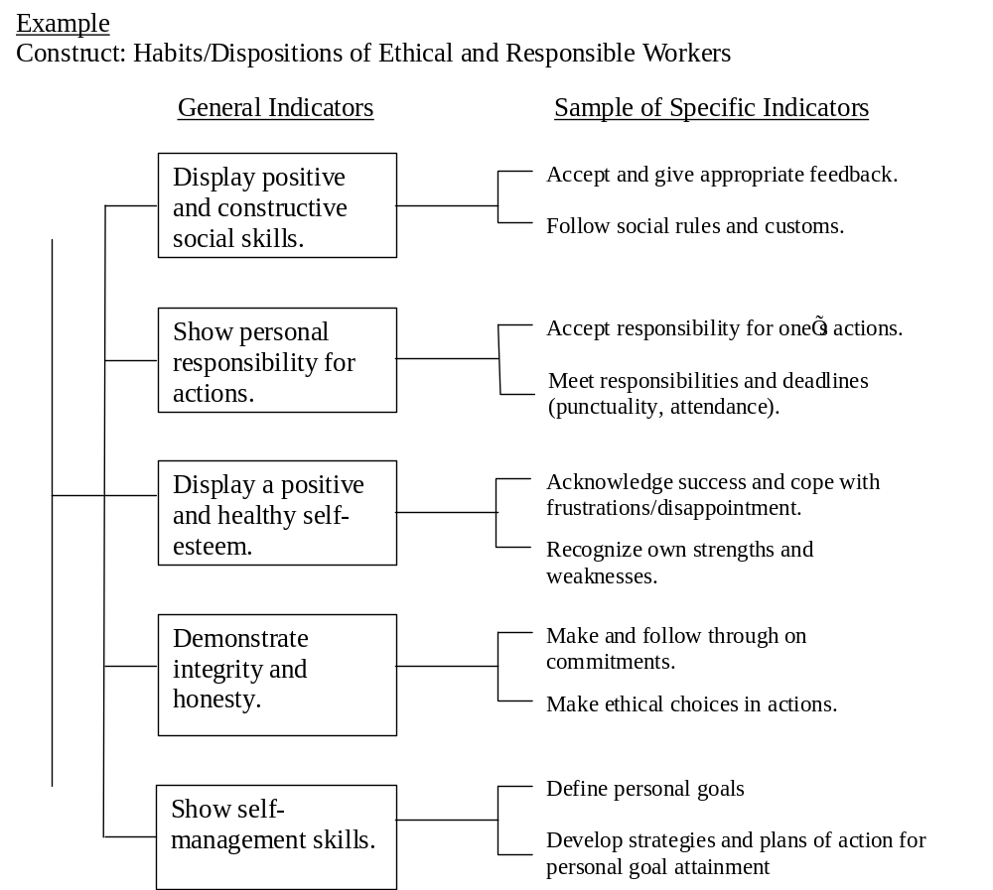

Slide 11
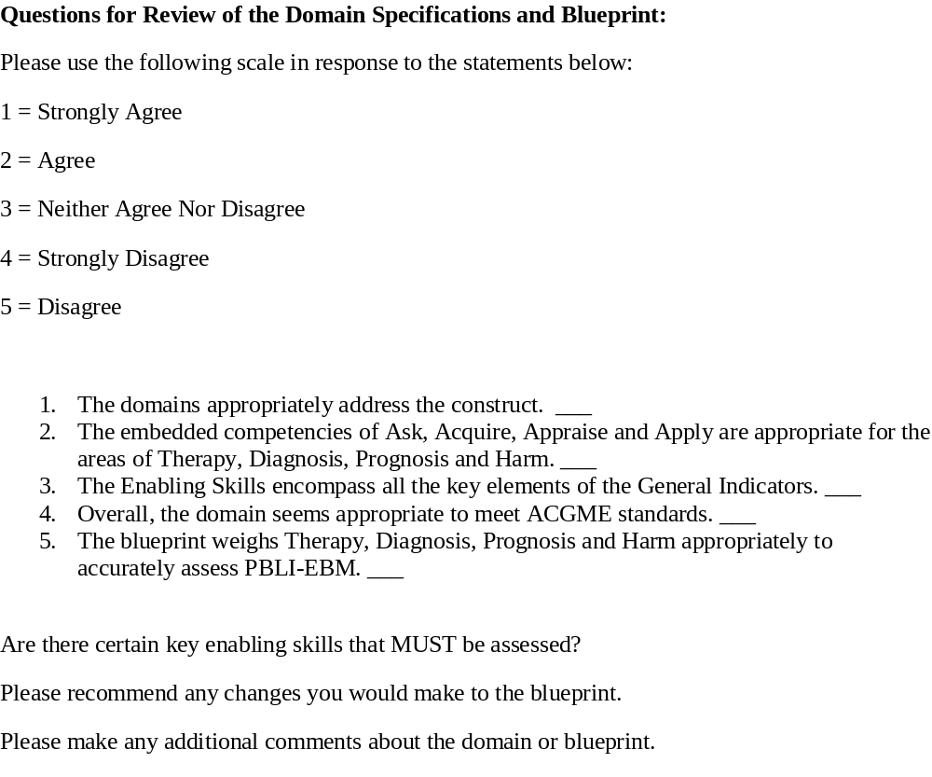
Content Validation Checklist: Medical Education Competency Assessment (Case 2)

Slide 12
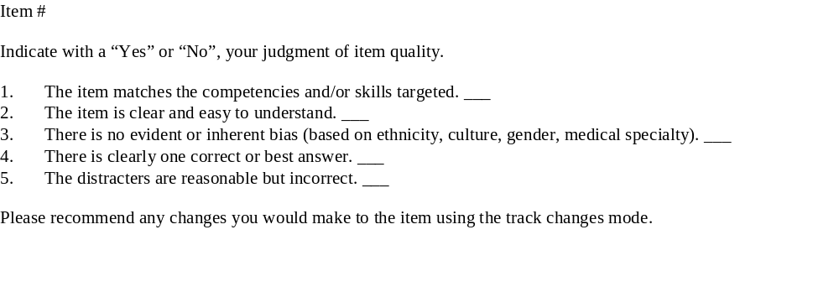
Content Validation Checklist: Medical Education Competency Assessment (Example 1)

Slide 13
Content validation “experts”
Choice of qualified experts is critical to obtaining useful content validity data
  Experts in the construct theory and domains (e.g. psychological experts for an attitudinal attribute)
  Experts in a relevant field of practice (practitioners, e.g., educators who specialize in the population)
  Ideal N: 3-6

Slide 14
II. Types of Validity Evidence
(2) Correlational Evidence of Validity (e.g., Convergent Validity and Discriminant Validity Evidence)
Questions:
  Do the scores of my instrument correlate as expected (e.g., positively) with scores of other instruments tapping the same or similar constructs, as predicted by theory or the literature?
  Do they show no relationship or correlate negatively with scores of other instruments tapping dissimilar constructs, as predicted by theory?
Type of Data Collected: Quantitative, empirical
Type of Analyses (examples): Correlational
Correlation matrix; inter-factor correlations, other more sophisticated methods, such as,
Multi-Trait Multi-Method (MTMM) matrix using latent trait models
When to Collect? After an instrument has been content-validated and revised. First iteration/revision should be ideally completed

Slide 15
III. Types of Validity Evidence
(3) Evidence of Internal Structure and Dimensionality
Questions:
  Does an analysis of the person x item data matrix suggest one, two or more mathematically derived dimensions that are consistent with the theory about the construct ?
  Is there one ore more than one “latent factor” that explains the variance in item responses, as hypothesized based on the literature used to specify the domain?
Type of Data Collected: Quantitative, empirical
When Collected: After an instrument has been content-validated and revised. First iteration should be ideally completed.
Types of Analyses ( examples):
Factor Analysis (Exploratory Factor Analysis (EFA)
Confirmatory Factor Analysis (CFA)
Dimensionality analysis with Item Response Theory (IRT) models –Fit of item data to specified IRT models

Slide 16
Person x Item Matrix
(Rating Scale Data)
Raw score or Marginal score
 | I₁ | I₂ | I₃ | I₄ | … | I_{n}
P₁ | 2 | 2 | 5 | 4
P₂ | 1 | 4 | 3 | 3
P₃ | 2 | 3 | 3 | 3
P₄ | 1 | 5 | 3 | 4
:
:
P_{n}
Items
Persons
Marginal score
CTT: Observed score (X) = True score (T) + Error (E)

Slide 17
IV. Types of Validity Evidence
(4) Criterion-related Validity (Predictive Validity and Concurrent Validity)
Predictive Validity :
  Do the scores predict some future behaviors in target population?
  Do scores show relationships with future “criterion variables” , as consistent with theory?
  Does the size and direction of the correlation coefficient fit the intended interpretations and purposes for the measures ?
Concurrent Validity Question:
  Do the scores relate to current behaviors in the target population?
  Do scores show relationships with future “criterion variables” , as consistent with theory?
  Does the size and direction of the correlation coefficient fit the intended interpretations and purposes for the measures ?
  (Substitution)
Type of Data Collected: Quantitative, empirical
  Longitudinal (predictive validity)
  Cross-sectional (concurrent validity)
Type of Analyses: Correlation and regression techniques (usually) or variations thereof
When Collected: After content validation, internal factor structure evaluations, and convergent and discriminant validity tests are completed

Slide 18
V. Types of Validity Evidence
(5) Other types of validity evidence relevant to the assessment design context
Item quality and statistical properties vis-à-vis item design specifications
Group differences expected (or ruling out group-based biases)
EXAMPLE: Wyer & Chatterji study

Slide 19
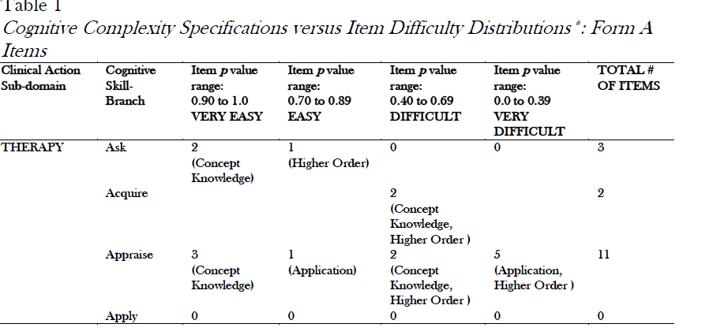
Validity evidence based on Item Difficulty Statistics- Illustration (Source: Wyer & Chatterji, 2013)

Slide 20
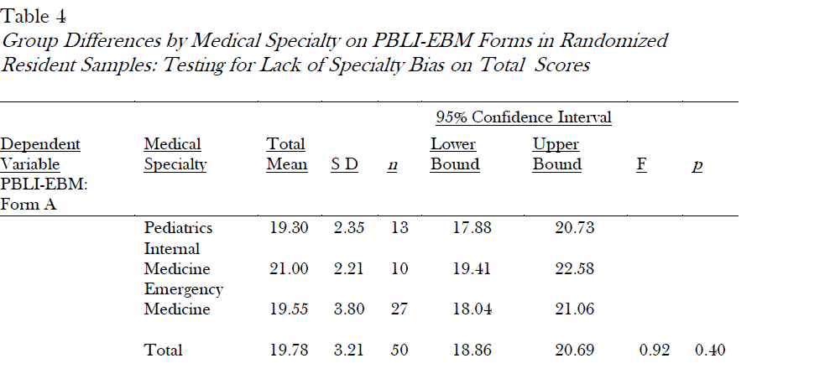
Validity evidence based on lack of group-specific biases ( Wyer & Chatterji, 2013)

Slide 21
Validation Plan Example- Designing Scales to Tap Math Self Efficacy, Self Concept and Anxiety
See Slides posted [NCME Presentation -Chatterji & Lin (2016) to go with Chatterji & Lin (2018) paper]
Discussion
What was the Validation Plan?
Could you draft a Validation Plan for your own instrument? ( Discussion only next week--Assignment 2, building on Assignment 1)

